Slide 1
DAY 1
Don’t panic
Text Editors
GUI vs Non-GUI
Autocomplete
Find within dir/file
Find and replace
Prettify on save
Live Share / Hot reloading
Git integration
Linters
HTML
Elements + tags
Syntax pattern
  Opening tags, closing tags
  Self-closing vs not
Attributes
Default styles
Semantics/Accessibility
Reliable resources
Chrome Dev Tools
Shortcut to open
Move window around
Inspector arrow button
CSS Selector breadcrumb
Box Model inspector
Grid & flexbox inspector
User agent stylesheet
CSS
Inline, embedded, external
Syntax pattern
Properties & values
Selectors
Box Model
Specificity waterfall
CSS reset

Slide 2
Group Roles
Project Manager
Facilitates. Keeps track of time. Makes sure everyone understands the tasks & gets to contribute their answers + ideas.
Back-End
Writes or types out group answers & ideas.
Front-End
Presents to the class.

Slide 3
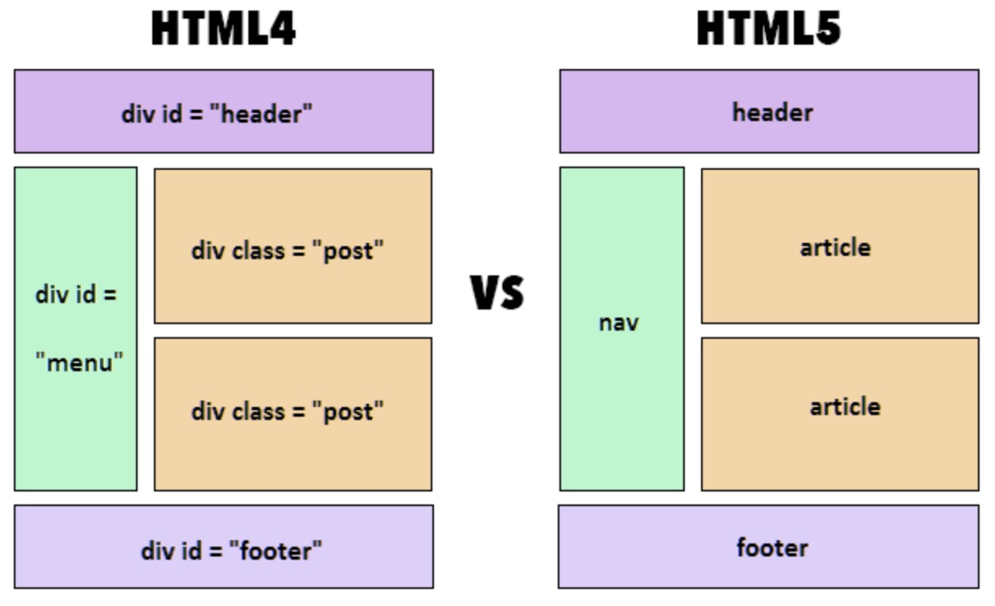

Slide 4
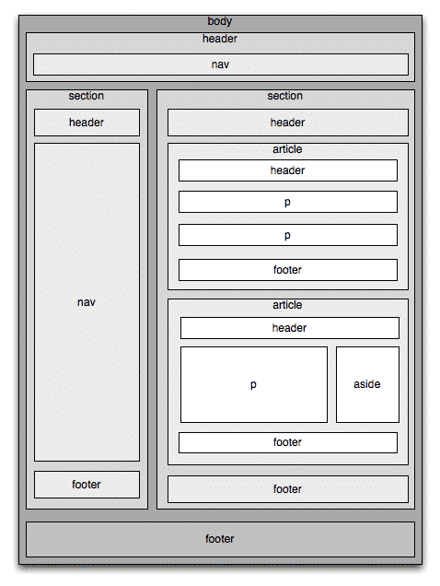

Slide 5
Name 3 different text/code editors
What is the current most popular text/code editor?
What is a GUI text editor vs a non-GUI text editor?
List your favorite text editor on the board (if not already there) and mark a tick next to it
Text Editors
</>

Slide 6

VS Code Emmet Shortcuts
Set Up Structure | ! + tab
Children | parent>child + tab
Build tags | tagname + tab
Multiplication | tagname*num + tab

Slide 7



HERO SECTIONS & CTA
CTA: Call to action
Above the fold: area of screen that can be seen before scrolling
20 conversion-boosting hero image website examples

Slide 8
Resources
What it be
Where it at
Default Element Styles
W3 Schools
HTML Attribute Reference
W3 Schools
VS Code Shortcuts - Emmet
Dev.to
Format with Prettier
DigitalOcean
Live Reload
freeCodeCamp
CSS Properties Reference
W3 Schools
CSS Selectors Reference
W3 Schools
CSS Background Img + Gradient
webdevetc

