Slide 1

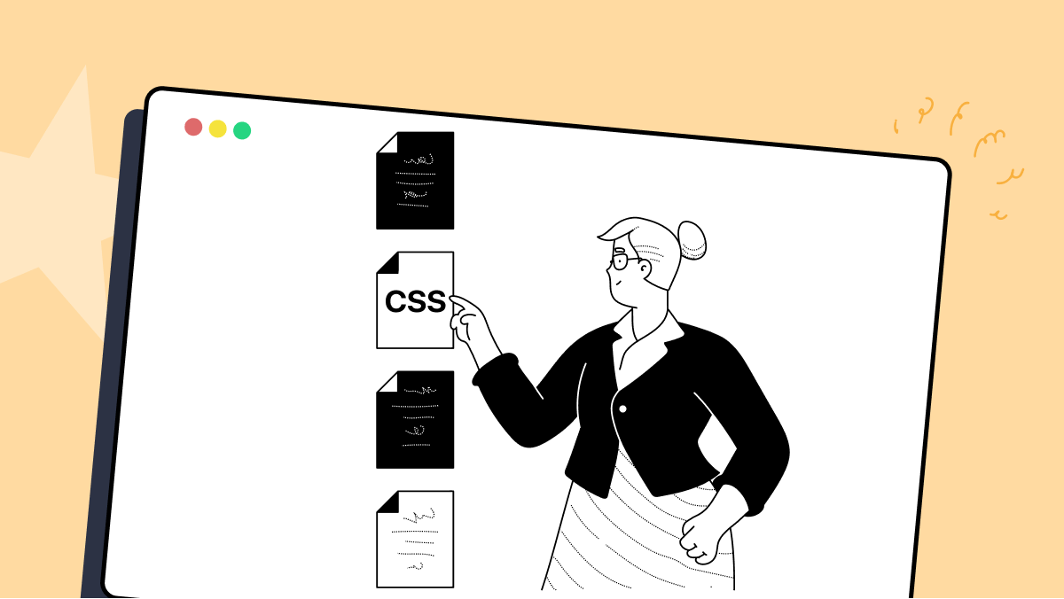
Research…
See if you can discover something that is new to HTML or CSS (that has been added within the last 2 years).
What is coming soon?
Be prepared to share something

Slide 2
DAY 3
Navbar
Grid
Scary or relieving?

Slide 3
CSS Grid
Grid for layout (like SE1400 wrapper grid)
Grid for grids of items

Slide 4
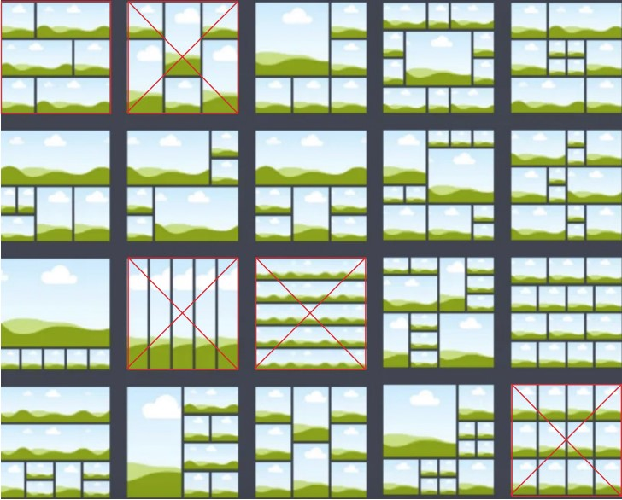

Slide 5
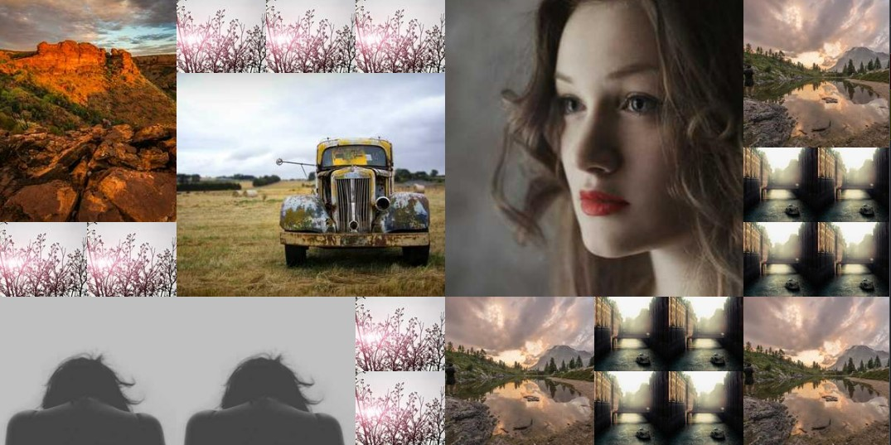

Slide 6
Resources
What it be
Where it at
Free Grid Course
Scrimba
Comprehensive Grid Guide
Creative Bloq
Free Icons
IconMonstr
IconFont
Font Awesome
Ionicons
Lorem Picsum
Picsum
Git Simplified
Roger Dudler
Git Cheat Sheet
freeCodeCamp
GitHub Desktop - Windows & Linux
Simplilearn
GitHub Desktop - MacOS
YouTube

