Slide 1
Review from yesterday
Simple Vue app
JavaScript for Vue in more detail
Static data (magic 8 ball)
Whack a mole
Address book challenge
Start project 1
MAKE SURE YOU HAVE A RIDE FOR WED LUNCH (TMR)
To-Do: 6/13

Slide 2

Vue: A JavaScript framework
Reactive
Don’t need to refresh page to see data changes
Declarative
Can build page templates
No longer need to query the DOM to access objects

Slide 3
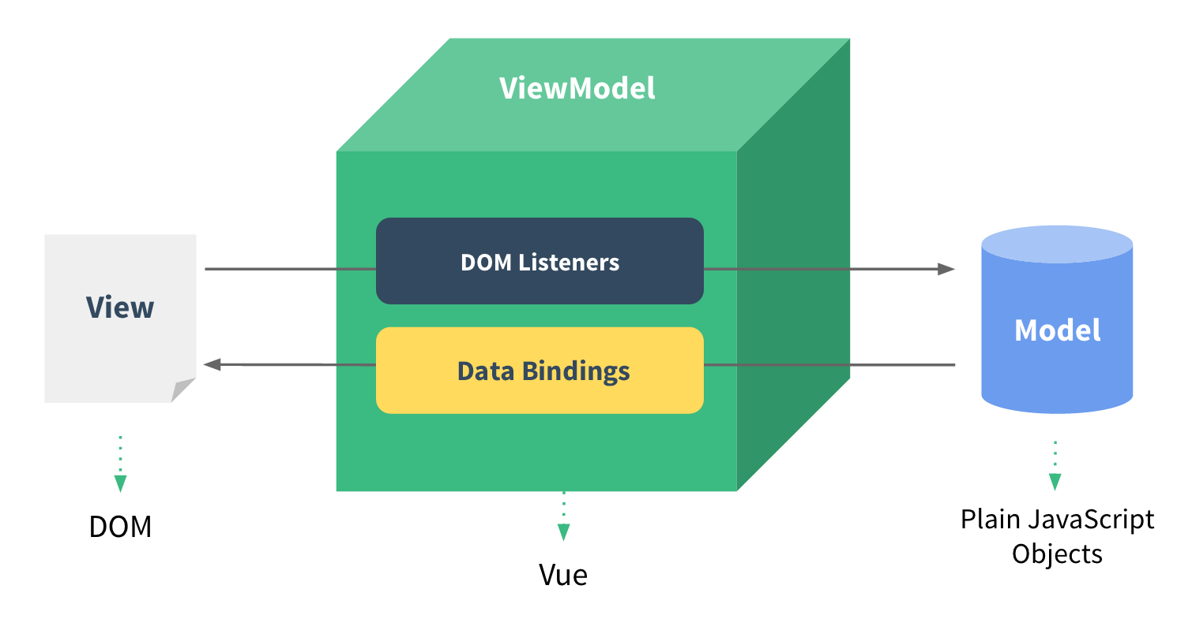
Single Page Application (SPA)
Handle data updates and navigation without reloading the page
Based in single index.html file
Vue Reference

Slide 4
Vue Directives
Reference
v-for = ”item in items”
Create an instance of an element for every item in items array
v-if = ”condition”
Render an element if condition is true
v-on:click = ”foo()”
When you click this element, call the function ‘foo.’ Other options include: :mouseover, :keydown, etc.
v-bind:style = ”{ color: ‘#fff’ }”
Change all text in this element white
v-else
Render an element if directly previous condition is not true
v-cloak
Special directive that hides element until Vue has fully loaded. Add to css as well:
[v-cloak] { display: none; }
v-model = ”modelname”
Bind ‘modelname’ data value and input value together (2-way data binding)
v-show = ”condition”
Display an element if condition is true

Slide 5
Templating / Declarative Rendering
If we have a Vue data property:
hotel = {
rooms: 40,
booked: 25,
name: ‘Red Cliffs’
}
To display a value on the page:
<p>{{ hotel.name }}</p>
Template syntax

Slide 6
JavaScript Quick Review
Global: variables can be accessed anywhere in our script
Local: variables are specific to a section of code and can only be accessed in that section (block)
In Vue:
this.dataProperty = kinda like self.data_member in Python
Need to use the ‘this’ keyword to access data properties in the Vue app

Slide 7
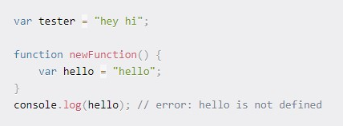
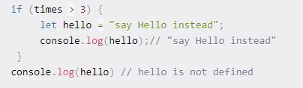

01
var
Global scope when OUTSIDE a function
Function/locally scoped when INSIDE function
Can be redeclared and updated
02
let
Scope is whatever block it’s in (if statement, function, etc.)
Can be updated but not redeclared
03
const
Scope is whatever block it’s in (like let)
Can’t be updated for redeclared
freeCodeCamp Example

Slide 8
JavaScript Objects
var hotel = {
rooms: 40,
booked: 25,
name: ‘Red Cliffs’
}
To access/update a property:
hotel.rooms = 50
Data properties can be any type
hotel.checkAvailability = function () { …do something }

Slide 9
JavaScript Functions
function print() {
// can access ‘this’
console.log(“Hello world);
}
OR
const print = () => {
// ‘this’ always refers to the outer global scope, so can’t access Vue objects
console.log(“Hello world”);
}

Slide 10
JavaScript Debugging
CONSOLE.LOG() PEOPLE!!!!
If something isn’t doing what you expect, check the console before you do anything else
To make everything will be 50% easier:
Learn to read the common error messages you get
Log variables and calculations as you go along - piece by piece programming
Don’t expect to code the entire thing or copy what I do and it just works

Slide 11
Resources
What it is
Where it’s at
Vue Boilerplate
GitHub
JavaScript Courses
freeCodeCamp

