Slide 1
Project 1 (Expenses app) cont.
  Watchers vs computed properties
  More about ternary operators
  API integration
  Search / Filter
  Sort
  Editing data
Dice game
To-Do List project
Zonos lunch @1
To-Do: 6/14

Slide 2

Binding Data
Style:
<div v-bind:style=”{color: someVueVariable}”>some content</div>
Class:
<div v-bind:class=”{ classNameHere: someVueVariable/Conditional}”>some content</div>

Slide 3
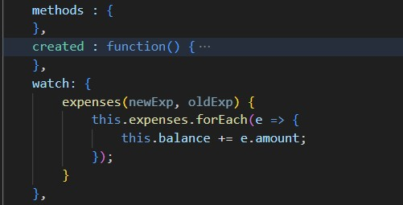
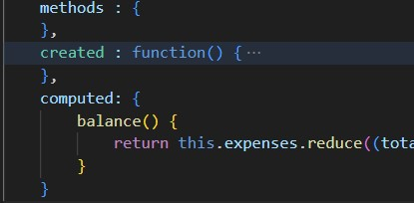
Watchers
Watchers vs. Computed properties
Computed Properties
Watchers
Goes in watch object of Vue
Will execute the function given every time the “watched” property changes, even if the actual value hasn’t changed
expenses is the name of a data property below - we watch to see if expenses changes
Computed Properties
Goes in computed object of Vue
Will cache the property = performance improves because if the dependencies haven’t changed, the property won’t need to recompute
balance is the name of a property - balance will be updated whenever one of the data properties used inside the function changes
do something like a function
do something like a function

Slide 4
Resources
What it is
Where it’s at
Class & Style Bindings
Vuejs.org

