Slide 1
Zonos visit LUNCH ON WED.
Intro to Vue
Intro project
Magic 8 Ball
Directives review
Converter calculator
To-Do: 6/12

Slide 2

What is Vue?
A JavaScript framework that makes building the frontend of a website easier and faster. It builds on top of JavaScript, HTML, and CSS.
Angular / AngularJS
React

Slide 3

Reactive
Don’t need to refresh the page to see new data
Vue tracks JS state changes, updates DOM when those changes happen
Declarative
Vue extends standard HTML with template syntax that allows us to “declaratively describe” HTML output based on JS state

Slide 4
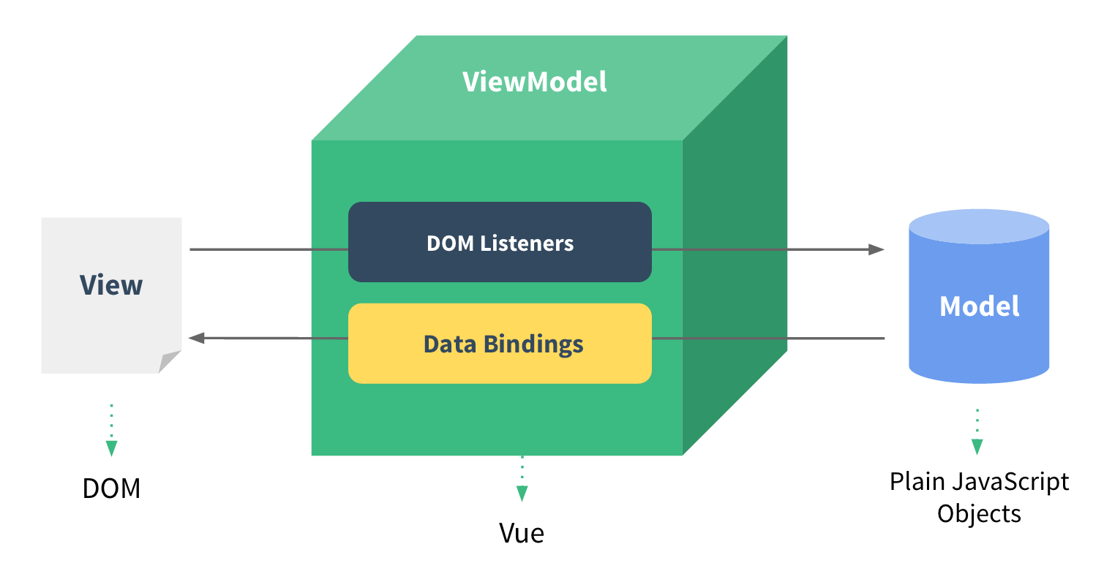
Single Page Application (SPA)
Handle data updates and navigation without reloading the page
Based in single index.html file
Vue Reference

Slide 5
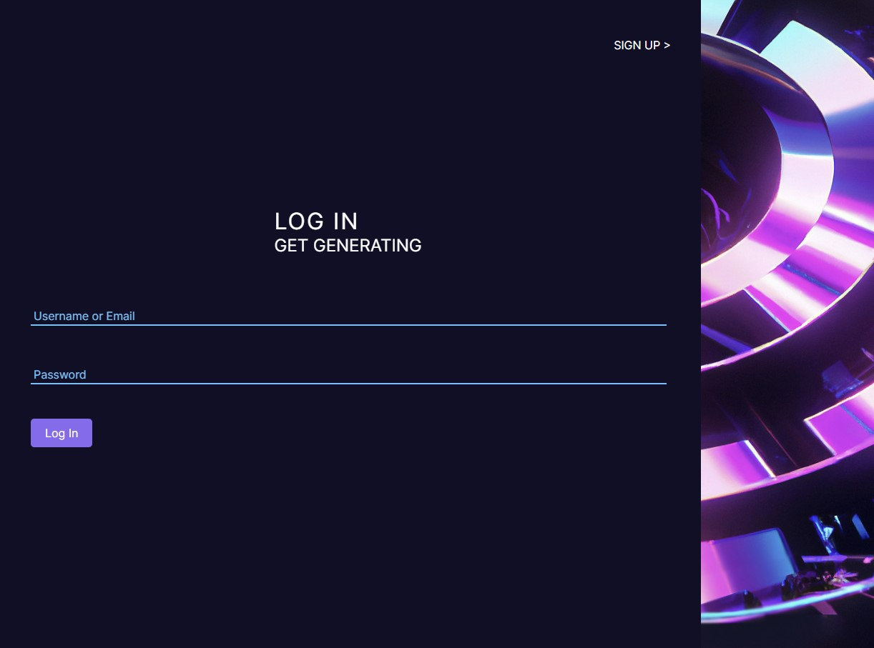


Vue Example
ImageForge
SPA that generates AI images
App

Slide 6
Magic 8 Challenge
Create a data property for the 8 ball’s message and display it in the message area
We already did:
Create a list of possible answers as a data property. When the user clicks the submit button, console log the question
Clear the input field after the user clicks the submit button
Still need to do:
Make sure the question is valid before allowing the user to submit (has a question mark at the end)
Change “Ask question” text to “not a valid question” if there’s no question mark (hint: v-if, v-else)
Hide the submit button if the question isn’t long enough (at least 1 char + ?)

Slide 7
Vue Directives
Reference
v-for = ”item in items”
Create an instance of an element for every item in items array
v-if = ”condition”
Render an element if condition is true
v-on:click = ”foo()”
When you click this element, call the function ‘foo.’ Other options include: :mouseover, :keydown, etc.
v-bind:style = ”{ color: ‘#fff’ }”
Change all text in this element white
v-else
Render an element if directly previous condition is not true
v-cloak
Special directive that hides element until Vue has fully loaded. Add to css as well:
[v-cloak] { display: none; }
v-model = ”modelname”
Bind ‘modelname’ data value and input value together (2-way data binding)
v-show = ”condition”
Display an element if condition is true

Slide 8
Resources
What it is
Where it’s at
Vue CDN
Vuejs.org
Documentation
Vuejs.org
Vue Boilerplate
GitHub
Directives
Vuejs.org

